Slide 1
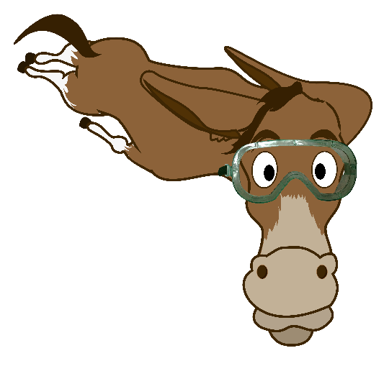
Diving deeper into memory
Barbara Oakley, PhD

Slide 2


Slide 3



Slide 4

force = mass x acceleration
f = ma

Slide 5
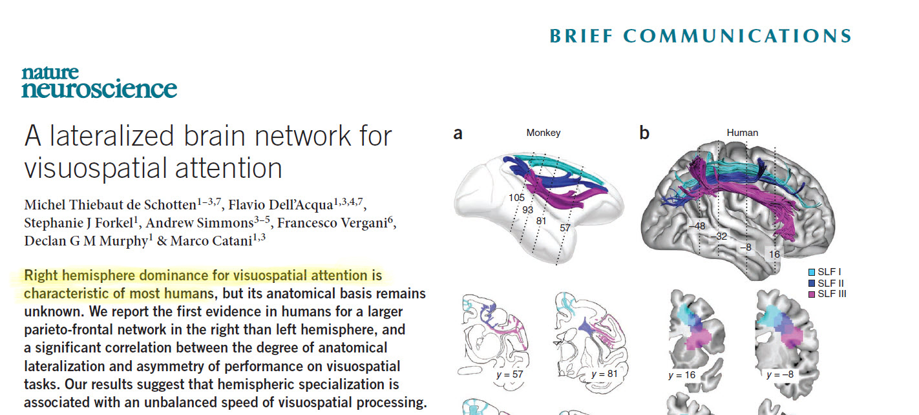

Slide 6
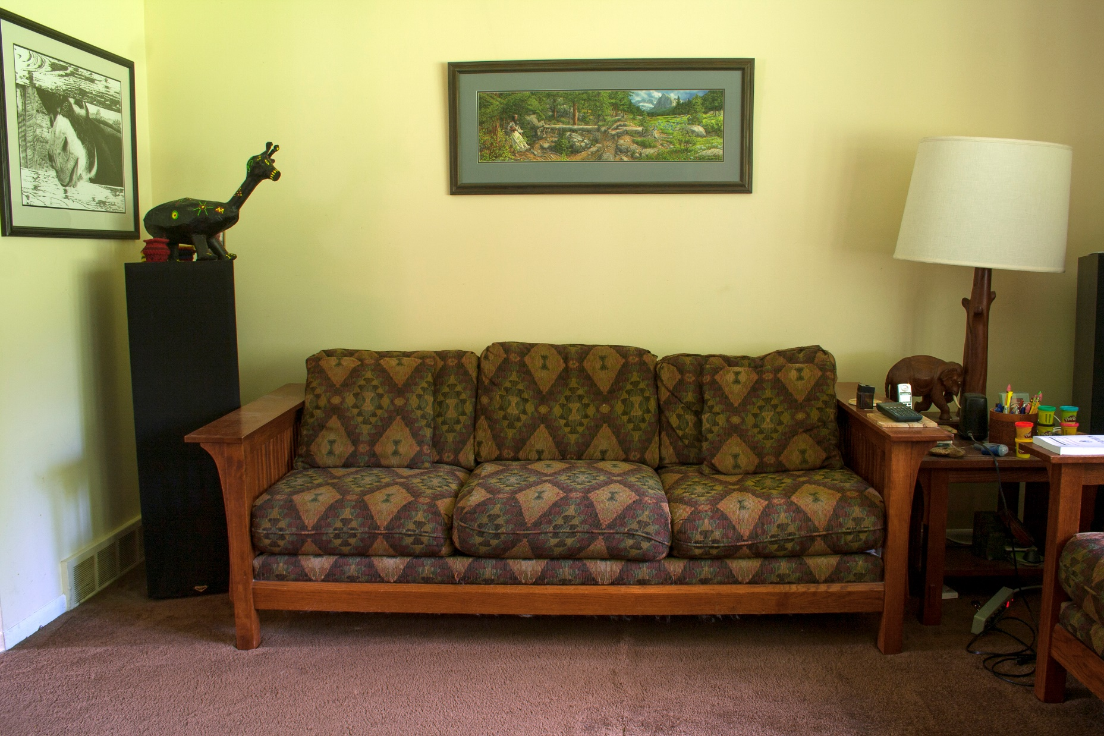
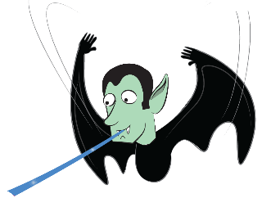
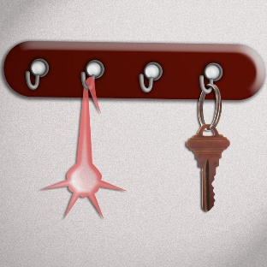
force = mass x acceleration
f = ma

Slide 7
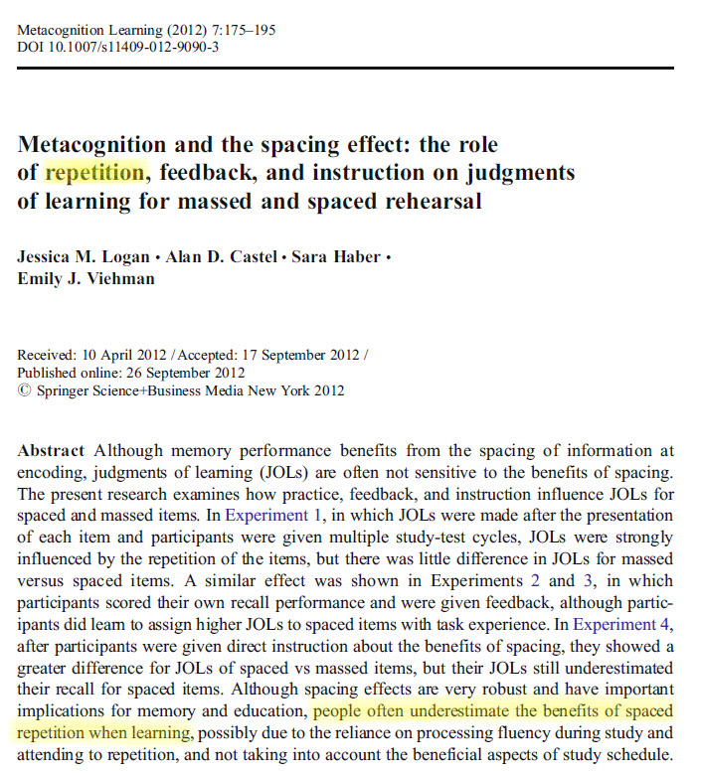

Slide 9
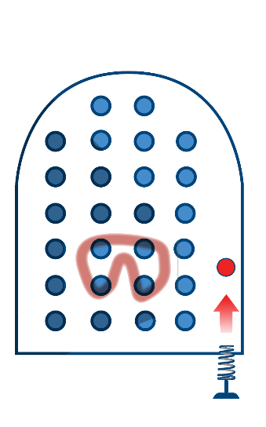
interleave

Slide 10

Jane Smith

Slide 11
Image Credits
Living room © Rachel Oakley, 2014.
House layout ©Kevin Mendez, 2014.
“Visual” fMRI image from Moussa, MN, MR Steen, PJ Laurienti, and S Hayasaka. "Consistency of Network Modules in Resting-State Fmri Connectome Data." PLoS ONE 7, no. 8 (2012): e44428; also see http://en.wikipedia.org/wiki/Resting_state_fMRI#mediaviewer/File:RestingStateModels.jpg.
Thiebaut de Schotten, M., F. Dell'Acqua, S. J. Forkel, A. Simmons, F. Vergani, D. G. Murphy, and M. Catani. "A Lateralized Brain Network for Visuospatial Attention." Nat Neurosci 14, no. 10 (Oct 2011): 1245-6.
Flying mule, ©Kevin Mendez, 2014.
Pinball, ©Kevin Mendez, 2014.
Logan, Jessica M., Alan D. Castel, Sara Haber, and Emily J. Viehman. "Metacognition and the Spacing Effect: The Role of Repetition, Feedback, and Instruction on Judgments of Learning for Massed and Spaced Rehearsal." Metacognition and Learning 7, no. 3 (2012): 175-95.
Anki image, http://ankisrs.net/
Clip art courtesy Microsoft Corporation
Relevant Readings
Baddeley, Alan, Michael W. Eysenck, and Michael C. Anderson. Memory. NY: Psychology Press, 2009.
Ellenbogen, J.M., P.T. Hu, J.D. Payne, D. Titone, and M.P. Walker. "Human Relational Memory Requires Time and Sleep." PNAS 104, no. 18 (2007): 7723-28.
Ericsson, K.A., and R.W. Roring. "Memory as a Fully Integrated Aspect of Skilled and Expert Performance." Psychology of Learning and Motivation 48 (2007): 351-80.
Foer, J. Moonwalking with Einstein. NY: Penguin, 2011.
Guida, A., F. Gobet, H. Tardieu, and S. Nicolas. "How Chunks, Long-Term Working Memory and Templates Offer a Cognitive Explanation for Neuroimaging Data on Expertise Acquisition: A Two-Stage Framework." Brain and Cognition 79, no. 3 (Aug 2012): 221-44.

Slide 12
Relevant readings (cont.)
Leutner, D., C. Leopold, and E. Sumfleth. "Cognitive Load and Science Text Comprehension: Effects of Drawing and Mentally Imaging Text Content." Computers in Human Behavior 25 (2009): 284-89.
Levin, J.R., M.E. Levin, L.D. Glasman, and M.B. Nordwall. "Mnemonic Vocabulary Instruction: Additional Effectiveness Evidence." Contemporary Educational Psychology 17, no. 2 (1992): 156-74.
Logan, Jessica M., Alan D. Castel, Sara Haber, and Emily J. Viehman. "Metacognition and the Spacing Effect: The Role of Repetition, Feedback, and Instruction on Judgments of Learning for Massed and Spaced Rehearsal." Metacognition and Learning 7, no. 3 (2012): 175-95.
Longcamp, Marieke, Céline Boucard, Jean-Claude Gilhodes, Jean-Luc Anton, Muriel Roth, Bruno Nazarian, and Jean-Luc Velay. "Learning through Hand- or Typewriting Influences Visual Recognition of New Graphic Shapes: Behavioral and Functional Imaging Evidence." Journal of Cognitive Neuroscience 20, no. 5 (2008/05/01 2008): 802-15.
Maguire, E.A., D.G. Gadian, I.S. Johnsrude, C.D. Good, J. Ashburner, R.S.J. Frackowiak, and C.D. Frith. "Navigation-Related Structural Change in the Hippocampi of Taxi Drivers." Proceedings of the National Academy of Sciences 97, no. 8 (2000): 4398-403.
Maguire, E.A., E.R. Valentine, J.M. Wilding, and N. Kapur. "Routes to Remembering: The Brains Behind Superior Memory." Nature Neuroscience 6, no. 1 (2003): 90-95.
Morris, Peter E, Catherine O Fritz, Louise Jackson, Emma Nichol, and Elizabeth Roberts. "Strategies for Learning Proper Names: Expanding Retrieval Practice, Meaning and Imagery." Applied Cognitive Psychology 19, no. 6 (2005): 779-98.
Moussa, MN, MR Steen, PJ Laurienti, and S Hayasaka. "Consistency of Network Modules in Resting-State Fmri Connectome Data." PLoS ONE 7, no. 8 (2012): e44428.
Smoker, Timothy J, Carrie E Murphy, and Alison K Rockwell. "Comparing Memory for Handwriting Versus Typing." Paper presented at the Proceedings of the Human Factors and Ergonomics Society Annual Meeting, 2009.
Thiebaut de Schotten, M., F. Dell'Acqua, S. J. Forkel, A. Simmons, F. Vergani, D. G. Murphy, and M. Catani. "A Lateralized Brain Network for Visuospatial Attention." Nat Neurosci 14, no. 10 (Oct 2011): 1245-6.

